Slide 1

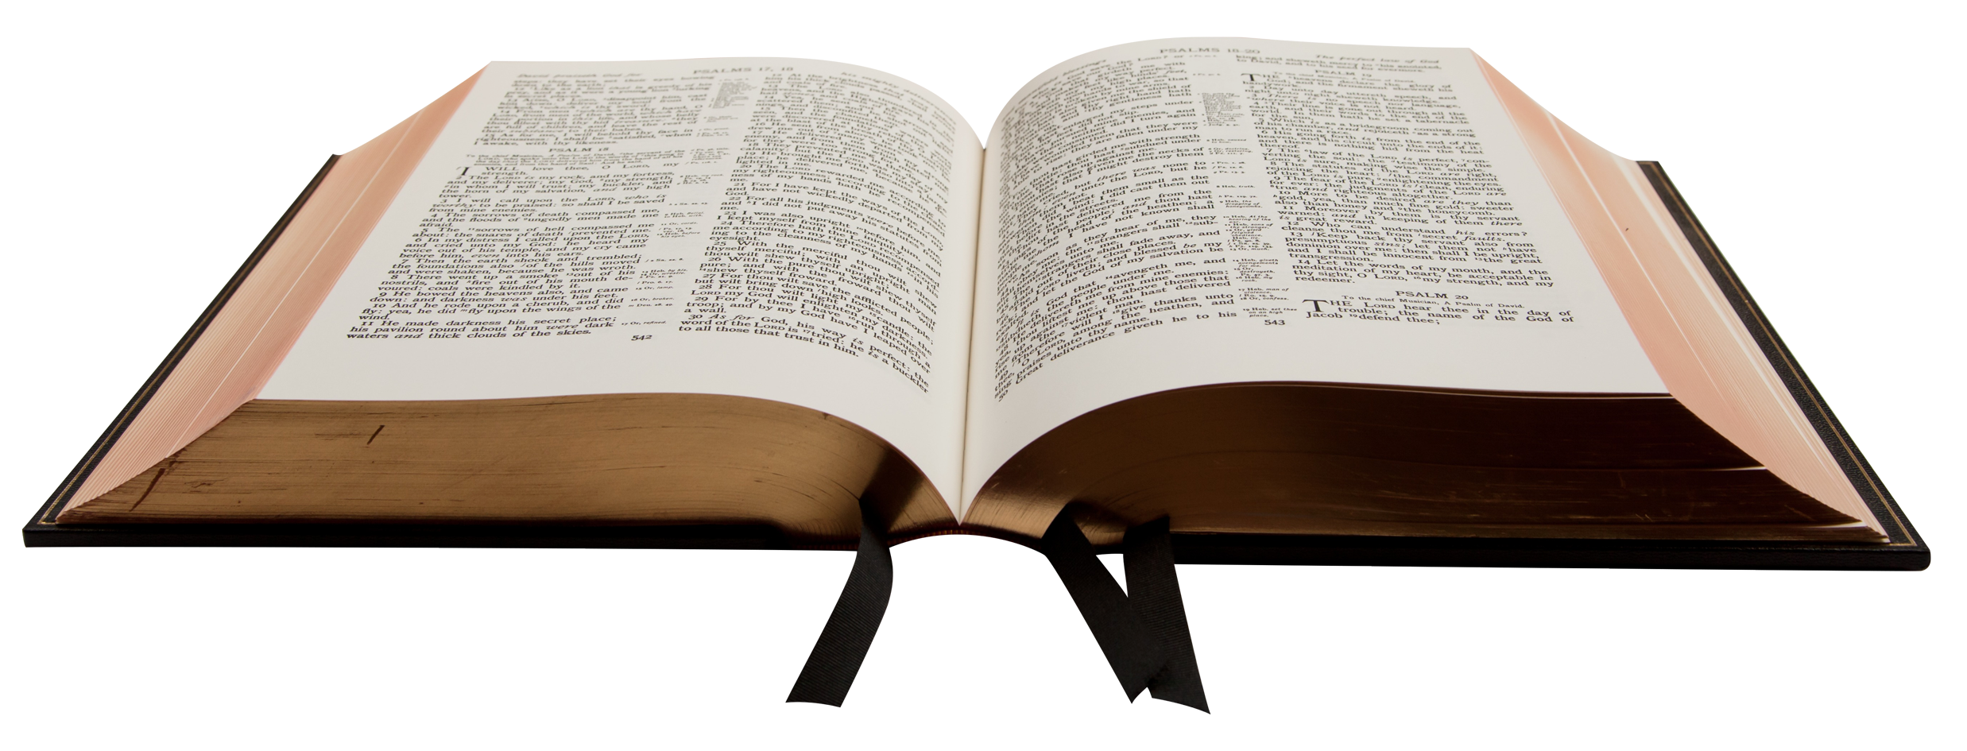
Be Devoted to …
The Apostles’ Teaching

Slide 2
Be Devoted to …
The Apostles’ Teaching
Fellowship
The breaking of bread
Prayer

Slide 3
Be Devoted to …
The Apostles’ Teaching

Slide 4
The Spirit of God leads the people of God to submit to the Word of God.

Slide 5

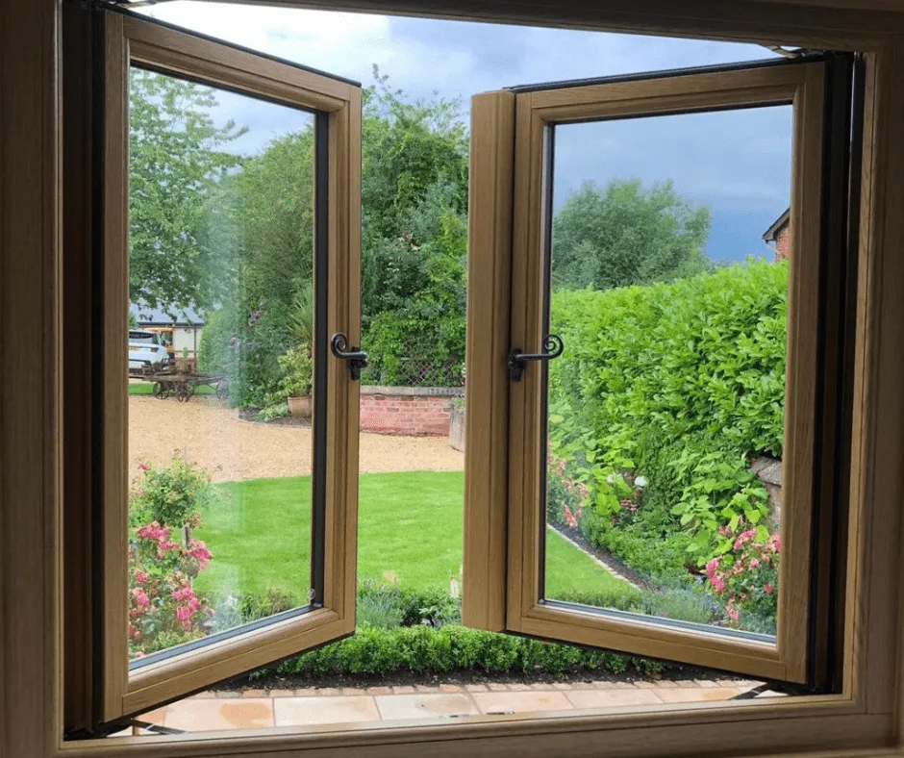
The Bible:
A window into our salvation
A door to our relationship with Jesus
Like newborn babies, crave pure spiritual milk so that by it you may grow up in your salvation.
1 Peter 2:2

Slide 6
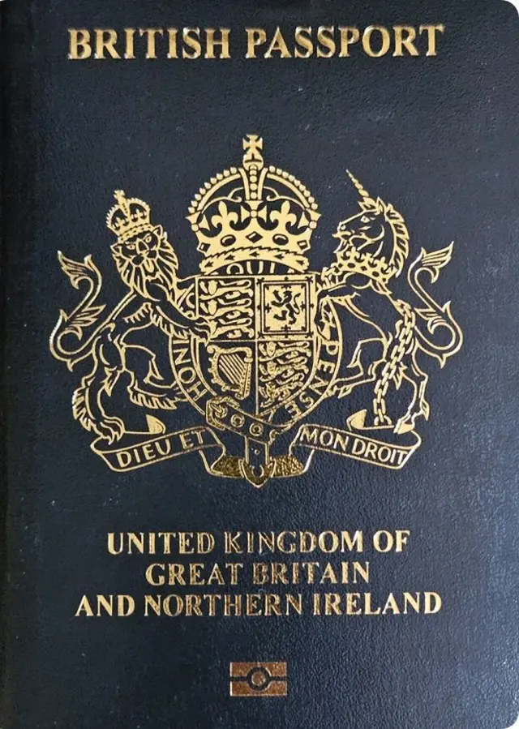
The Bible:
Identifier of who we are in God
How great is the love the Father has lavished on us, that we should be called children of God! And that is what we are! 1 John 3:1-2

Slide 7

The Bible:
An instrument of change.
“Is not my word like fire,” declares the Lord, “and like a hammer that breaks a rock in pieces? Jeremiah 23:29

Slide 8

The Bible:
A Guide for daily life.
Your word is a lamp to my feet and a light to my path. Psalm 119:105

Slide 9
The Spirit of God leads the people of God to submit to the Word of God.

